Slide 1


Main Goal
Develop a Computer Vision Algorithm which can track particular objects and stabilize the video with respect to the object
The problem is a variation of the Video Stabilization Algorithm with the constraint that the video of the main object should remain stable

Slide 2

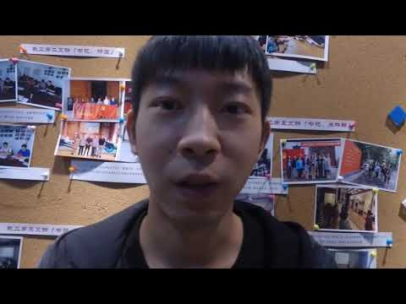
Selfie Video to be Stabilized

Slide 3
Proposed Algorithm
Overall Process can be divided into multiple sub parts:
Object Detection and Tracking
Trajectory Estimation and Smoothing
Stabilization wrt tracked object
Tracking missing part and Mask Construction
Video Inpainting to fill missing part

Slide 4
Object Detection
YoloV5 is used for detecting object throughout the video
When run on each frame the Algorithms outputs a Bounding Box for the object
The Bounded Boxes predicted are then used for tracking
Bounding Boxes may not be precise and may fluctuate a lot leading to bad tracking
In the next slide we have a video showing the result of running YOLO on the entire video this detects and outputs the bounding boxes in each frame

Slide 5
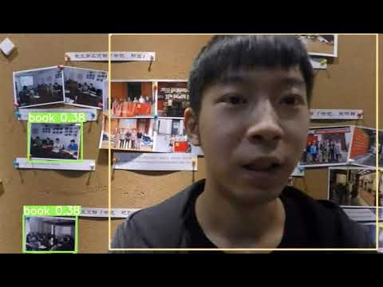
YoloV5 Result on Video

Slide 6
Naïve Tracking using box centres
Output Bounding boxes of face for each frame and track centres of the bounding boxes
Bounding boxes fluctuate and are not accurate
In the video shown in the next slide the box centres are tracked and the tracked centre is shown as a white dot in each frame
This is obtained by getting the bounding box using YOLO and using the centre of the bounding boxes for tracking the object
In a ideal tracking there should be no relative motion between the face which is being tracked and the dot

Slide 7

Result of YOLO tracked Video

Slide 8
Better Tracking Using Filters
In the previous video we see that the tracked dot keeps on moving all over the face showing that it is not a good tracking
Running YOLO on the whole video is very resource consuming and also does not output accurate trackings
A better way to approach the problem is using YoloV5 to output an initial bounding box for the object followed by using simpler and more accurate tracking algorithms for tracking this bounding box over the video
Run Yolo on first frame to get initial bounding box
Track bounding box
over all frames using
Filter based methods

Slide 9
Algorithms for tracking Bounding Box
Filter Based Algorithms for tracking bounding boxes are faster and can track more accurately than YoloV5
Some Algorithms which were experimented with are:
MOSSE (Minimum Output Sum of Squared Error)
Very Fast, Low Accuracy
KCF (Kernelized Correlation Fitlers)
Relatively Fast, Mid Accuracy
CSRT (Discriminative Correlation Filter)
Relatively Slow, High Accuracy

Slide 10
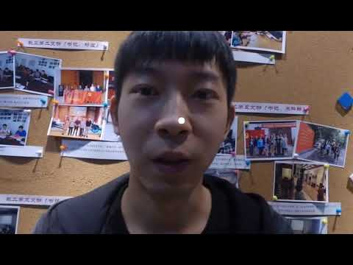
Our Application needs mid to high accuracy
KCF and CSRT are suitable alternatives
Below is video demonstrating CSRT tracking
Centre of tracked Bounding Box is shown as white dot

Slide 11
Results
As we see CSRT tracking is much more accurate !!
The white dot is more or less constrained to the nose of the person showing it is an accurate tracking !!!
Along with accuracy it is also 2-3 times faster than running YOLO on the whole video
Hence, the previously described method of first running YOLO to get a bounding box followed by tracking the bounding box using filters is a much better measure

Slide 12
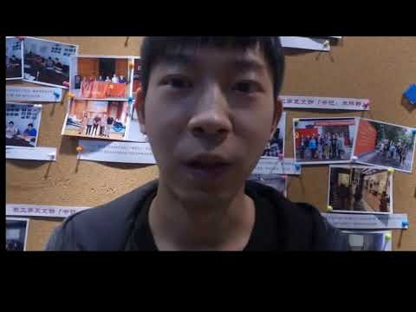
Stabilization wrt object
Assuming the motion of the object is in 2-Dimension or Affine
For stabilization wrt tracked object a simple affine transform is used to put the object at the centre of the video.
The result of the stabilization based on the tracked motion is shown below

Slide 13
Filling in Missing Black Areas
Missing Areas in a frame as a result of stabilization are a common problem in Video stabilization
Two ways to Handle this:
Crop Out the missing areas and get a smaller video
However, these missing areas sometimes constitute over 50% of the frame
Use Video Completion techniques to fill these in using other frames
Only possible when other half of the video is shown in previous frame
Since, our case involves large amount of motion the first option of cropping would mean we only have a video of the face with the background lost.
Hence, we consider methods of video completion

Slide 14
Video Inpainting /Completion
First a naïve approach is used of simply replacing missing part by median intensity of transformed images taken over time
Median of intensity is taken over all possible transformed frames after removing the missing pixels and sorting them according to intensity
This median operation is over time and through this we obtain a single median frame
This was suggested by Matsushita et Al (2006)
Find Median Frame by Intensity
Fill with Median Intensity
Frame wherever some part is missing

Slide 15
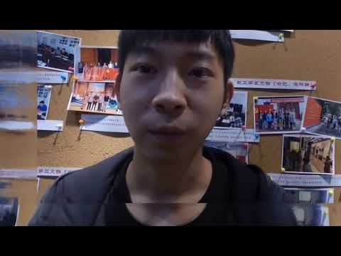
Median Completed Video
We see that the median completed video does not have good quality due to high variance and change over frames
The problem is more complex and better methods need to be used

Slide 16
Deep Learning Based Approaches
Since we see that a simple approach is not enough since the variance in pixels can be high
Deep Learning Based Approaches Give Better Results
For this application approach given in Learning Joint Spatial-Temporal Transformation Networks for Video Inpainting by Zeng et al is used

Slide 17
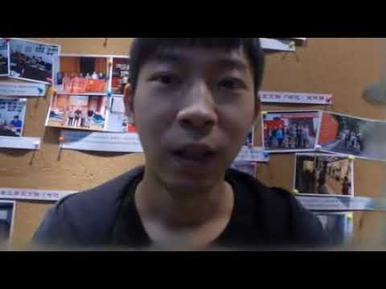
STTN Completed Video

Slide 18
Ways to improve Filling
The Reason the previous method fails is that at times we are trying to fill around half of the frame
Video Completion methods only work well when around 10-15 Percent of the frame is missing
A way to solve this is to break the completion process into parts and perform stabilization and completion alternatively

Slide 19
Limitations of Video Filling Approaches
Video filling approaches can only work when the rest of the scene is revealed in the other frames ie if the other frames don’t have the information to fill the frame it will not be possible to do so
Hence, in videos where we have a moving object filling may not be possible. Since the camera being stable does not tell us about other frames
However, in videos where we have a moving camera the rest of the scene is revealed due to motion of camera
Hence, video completion works best for no object motion an only camera motion
If we want to include video completion in our pipeline we have to restrict the domain of our problem to videos in which we only have camera motion.

